Slide 1
Absorption of minerals and water in plants
Year 11 Biology
Bremer SHS

Slide 2
Learning goals
-explain how water and dissolved minerals move through xylem via the roles of root pressure, transpiration stream and cohesion of water molecules
-discuss the factors (light, temperature, wind, humidity) that influence the rate of transpiration

Slide 3
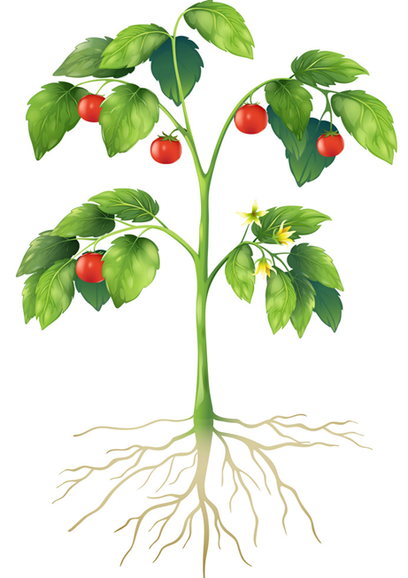
Warm up
Label the following diagram with the parts of a plant.

Slide 4
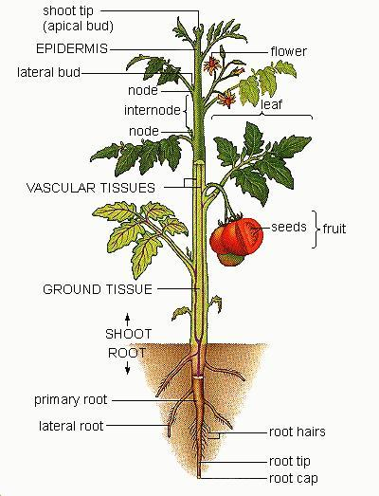
Plant structure
Seed baring plants have three main structures:
Roots
Stems
Leaves
What are the role/s of these structures?

Slide 5
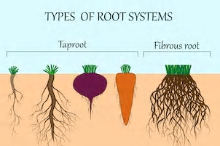
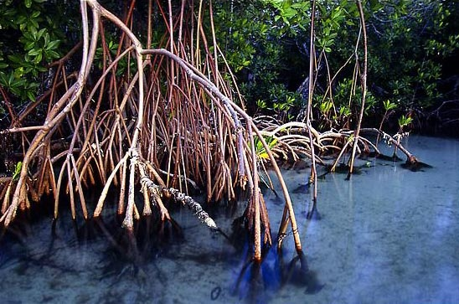
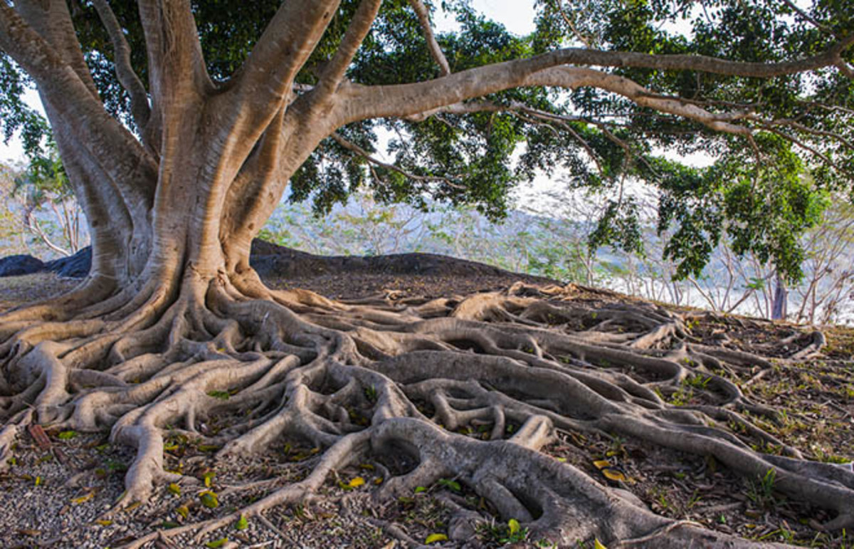
Roots
Roots have a variety of functions such as:
Providing a large surface area for absorption and transport water and nutrients
Anchoring plant to the ground
Holding soil in place and prevent erosion
Storage of sugars made in photosynthesis
The greatest reported depth to which a tree’s roots have penetrated is 120m by a Wild Fig tree at Echo Caves in South Africa.
The Greatest Spread of a tree occurs on a Banyan tree in the Indian Botanical Gardens in Calcutta. It has 1,775 prop or support roots, a circumference of 410m, covers 12 000m².

Slide 6
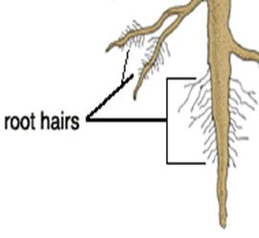
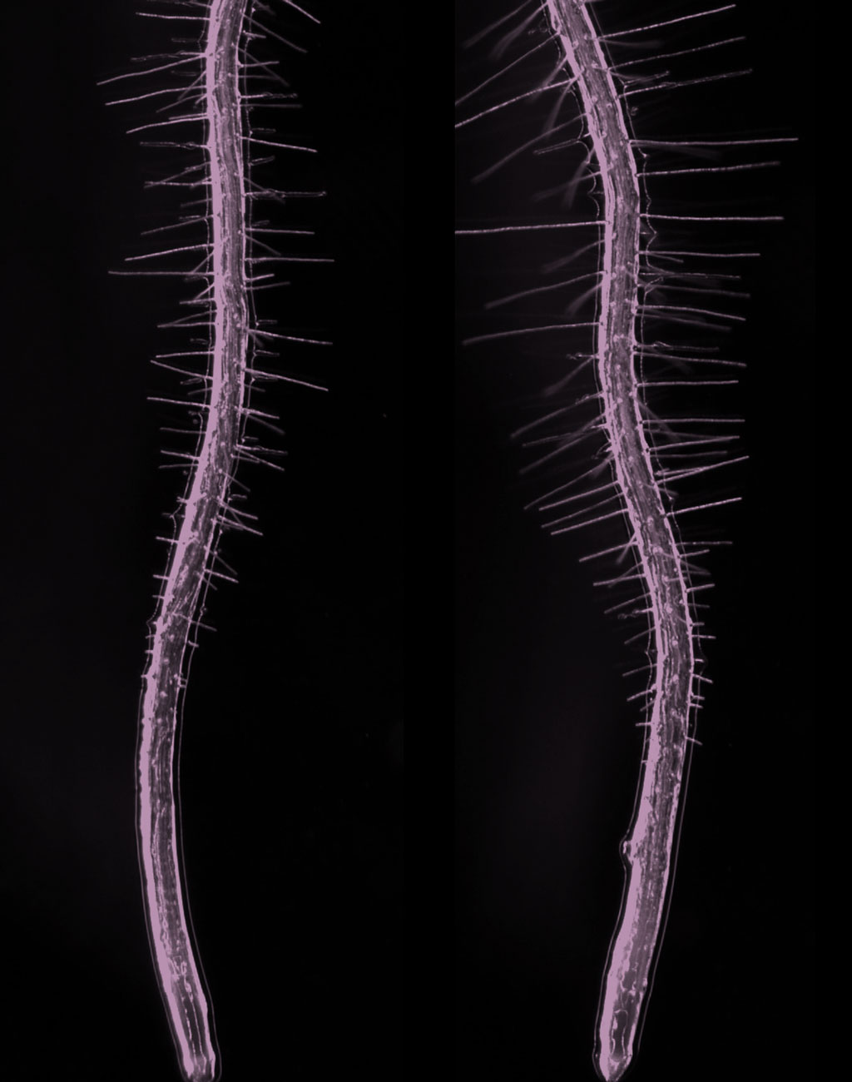
Root hairs
The root is the major absorption organ in all soil living plants
The zone of maximum water absorption is located about 20-200 mm from the root tip and this region is full of root hairs.
These “hairs” increase the water absorbing surface area to allow for maximum absorption.
Root hairs range from 0.1 mm to 10 mm and the density of root hairs is 2500 hairs per cm²

Slide 7
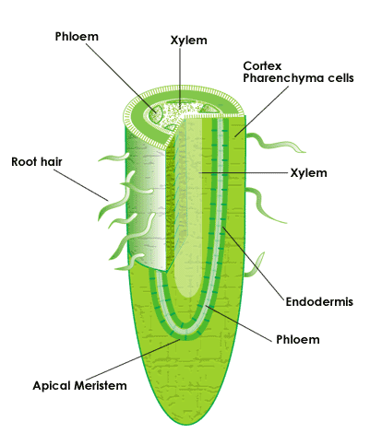
Xylem and phloem
The xylem and the phloem make up the vascular tissue of a plant and transports water, sugars, and other important substances around a plant.
Phloem and xylem are closely associated and are usually found right next to one another.
Xylem tissue is used mostly for transporting water from roots to stems and leaves but also transports other dissolved compounds.
Phloem is responsible for transporting glucose produced from photosynthesis from leaves to non-photosynthesizing parts of a plant such as roots and stems.

Slide 8
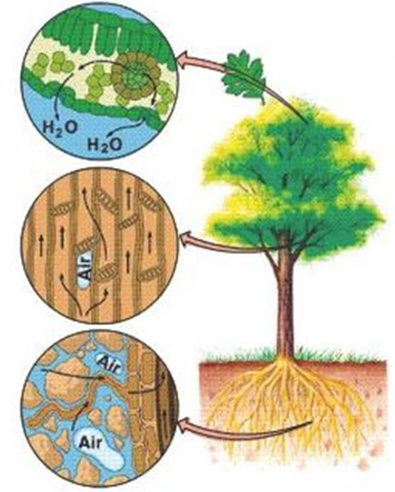
Water movement against gravity
Water is transported up a plant against gravity without a “pump”.
Mechanisms for moving water include:
Root pressure
Cohesion-tension
Transpiration
Video link: https://youtu.be/5CMrK8rlzZw

Slide 9
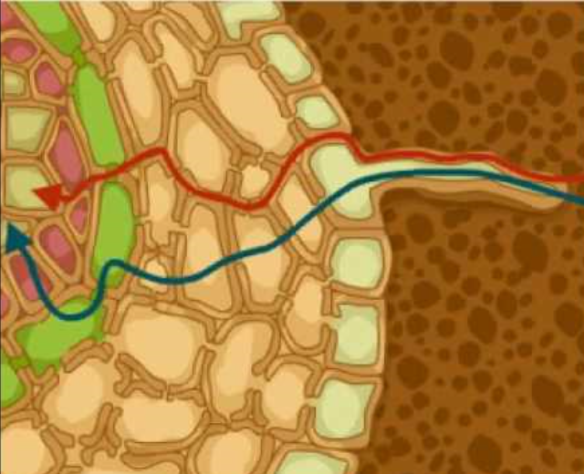
Root pressure
Root pressure relies on positive pressure that forms in the roots as water moves into the roots from the soil.
Water moves into the roots from the soil by osmosis, due to the low solute potential in the roots (lower water pressure in roots than in soil).
This intake of water in the roots increases water pressure in the root xylem, driving water up.
Root pressure can only move water against gravity by a few meters, so it is not strong enough to move water up the height of a tall tree.
Water may take two pathways in the root. It can pass through the cytoplasm of one cell in to the next or through specialised pathways in the cell membrane and cell wall.

Slide 10
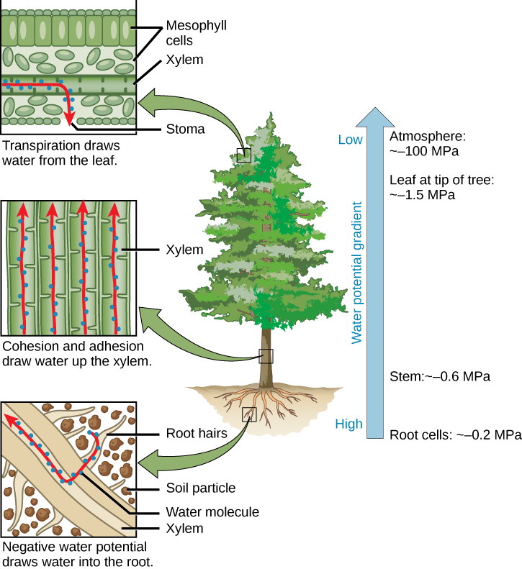
Transpiration
Transpiration is a passive process, meaning that ATP is not required for water movement.
The energy driving transpiration is the water potential difference between the water in the soil and the water in the atmosphere.
Regulation of transpiration is achieved primarily through the opening and closing of specialised structures called stomata on the leaf surface.
When stomata are open, water vapour is lost to the external environment, increasing the rate of transpiration.

Slide 11
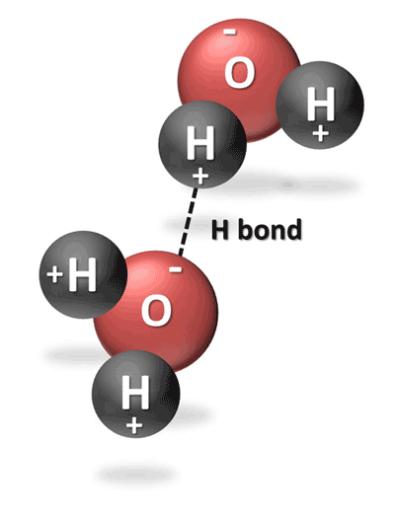
Cohesion- tension
The tension created by transpiration “pulls” water in the plant xylem, drawing the water upward in much the same way that you draw water upward when you suck on a straw.
Cohesion (water molecules sticking to each other) causes more water molecules to fill the gap in the xylem as the top-most water is pulled toward the stomata.
In water, cohesion occurs due to hydrogen bonding between water molecules.

Slide 12
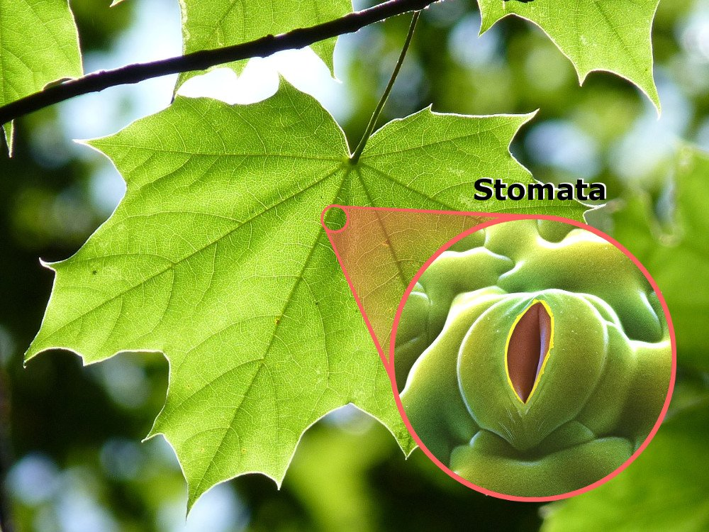
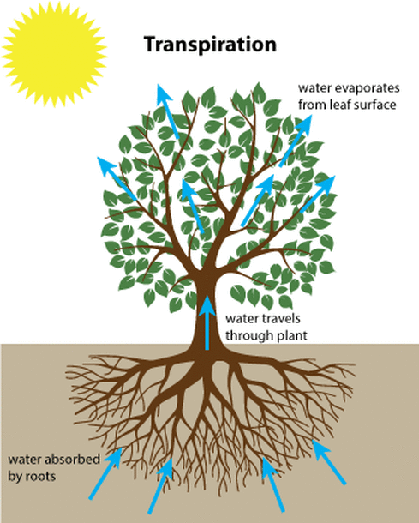
Factors that affect transpiration
Temperature increases the rate of transpiration because evaporation is faster at higher temperatures.
Humidity decreases the rate of transpiration because diffusion of water vapour out of the leaf slows down if the leaf is already surrounded by moist air.
Wind speed increases the rate of transpiration because moving air removes water vapour, increasing the rate of diffusion of water vapour from the leaf.
Light intensity increases the rate of transpiration because the stomata open wider to allow more carbon dioxide into the leaf for photosynthesis.

Slide 13
Check for understanding
Explain how root pressure, transpiration and cohesion-tension work together to move water molecules against gravity in plants.
Describe how the water potential changes from the roots to the leaves of a plant.
Explain why an indoor plant enthusiast must water their plants more often if they live in high humidity environments.

